Slide 1
Automated Detection of Major Depressive Disorder (MDD) through Question-Answering
Srijanak De
Department of Computer Science and Engineering Indian Institute of Technology, Kharagpur
November 09, 2022

Slide 2
Table of Contents
Automated Detection of Major Depressive Disorder (MDD) through Question-Answering
Srijanak De
1. Introduction
Introduction
Background and Preliminaries
Understanding the Diagnostic Criteria for MDD
Getting Acquainted with the Structure of Questions
Problem Statements
2. Background and Preliminaries
Understanding the Diagnostic Criteria for MDD
Getting Acquainted with the Structure of Questions
3. Problem Statements
Summary of Work Done
Creating a Baseline Questionnaire Structure
Making the Baseline Adaptive to Newer Contexts and Rules
4. Summary of Work Done
Creating a Baseline Questionnaire Structure
Making the Baseline Adaptive to Newer Contexts and Rules
Future Work and Conclusion
5. Future Work and Conclusion
References
6. References

Slide 3
Introduction
Automated Detection of Major Depressive Disorder (MDD) through Question-Answering
Srijanak De
Introduction
Background and Preliminaries
Understanding the Diagnostic Criteria for MDD
Getting Acquainted with the Structure of Questions
Problem Statements
Depression is one of the most common mental illnesses worldwide, with an estimated 3.8% of the population affected.
In this work, we try to create a fully automated depression detection tool.
This entails asking patients’ relevant questions in accordance with an established diagnostic criterion and thereby analyzing the corresponding responses.
We propose a novel automated depression detection pathway which is adaptive to newer contexts, personified to patient’s responses, and flexible to rules as per user’s choices.
Summary of Work Done
Creating a Baseline Questionnaire Structure
Making the Baseline Adaptive to Newer Contexts and Rules
Future Work and Conclusion
References

Slide 4
Understanding the Diagnostic Criteria for MDD
Automated Detection of Major Depressive Disorder (MDD) through Question-Answering
Srijanak De
Introduction
Background and Preliminaries
Understanding the Diagnostic Criteria for MDD
Getting Acquainted with the Structure of Questions
Problem Statements
The Diagnostic and Statistical Manual of Mental Disorders, Fifth Edition (DSM-5) is used as the diagnostic criteria for MDD.
Clearly Present | Sustained
 |  | 1) Depressed mood most of the day, nearly every day as indicated by either subjective report (e.g., feels sad, empty, hopeless) or observation made by others (e.g., appears tearful). (Note: In children and adolescents, can be irritable mood).
Summary of Work Done
Creating a Baseline Questionnaire Structure
Making the Baseline Adaptive to Newer Contexts and Rules
Table 1: DSM-5 Section A 1st Criteria [1]
There are 8 more criteria in Section A apart from the one shown above and for a diagnosis of MDD to be present, 5 of those 9 criteria must be marked as both “clearly present” and “sustained”.
If the symptom corresponding to one of the 9 criteria has been sustained for at least two weeks, every day, most of the day, then the box “sustained” is marked.
At the same time conditions of Section B, C, D and E should also be met for a complete diagnosis of MDD.
Future Work and Conclusion
References

Slide 5
Getting Acquainted with the Structure of Questions
Automated Detection of Major Depressive Disorder (MDD) through Question-Answering
Srijanak De
Introduction
Background and Preliminaries
Understanding the Diagnostic Criteria for MDD
Getting Acquainted with the Structure of Questions
Problem Statements
CURRENT MAJOR DEPRESSIVE EPISODE | MAJOR DEPRESSIVE EPISODE CRITERIA
In the past month, since (ONE MONTH AGO), has there been a period of time when you were feeling depressed or down most of the day, nearly every day? (Has anyone said that you look sad, down, or depressed?) IF NO: How about feeling sad, empty, or hopeless, most of the day, nearly every day? IF YES TO EITHER OF ABOVE: What has it been like? How long has it lasted? (As long as 2 weeks?) | Depressed mood most of the day, nearly every day, as indicated by either subjective report (e.g., feels sad, empty, hopeless) or observation made by others (e.g., appears tearful). | – +
Summary of Work Done
Creating a Baseline Questionnaire Structure
Making the Baseline Adaptive to Newer Contexts and Rules
Future Work and Conclusion
Table 2: SCID-5-CV¹ A1 Questions [2]
References
The SCID-5-CV structure of questioning directly follows from the DSM-5 criteria as shown in the above table.

Slide 6
Problem Statements
Automated Detection of Major Depressive Disorder (MDD) through Question-Answering
Srijanak De
Automated Detection of Major Depressive Disorder through Question-Answering
The objective is to create a fully automated system that engages in interaction with a patient mainly through asking a series of questions and analyzes their corresponding responses to detect if the patient is diagnosed with depression. This task is segregated into the following sub-problems:
Creating a baseline questionnaire structure.
SCID-5-CV based on DSM-5 diagnostic criteria is replicated with only ‘yes’ or ‘no’ as answers.
Making the baseline adaptive to newer contexts and rules.
Increase pool of questions.
Use a tree structure to make addition, removal and re-ordering of questions/symptoms flexible.
Introduction
Background and Preliminaries
Understanding the Diagnostic Criteria for MDD
Getting Acquainted with the Structure of Questions
Problem Statements
Summary of Work Done
Creating a Baseline Questionnaire Structure
Making the Baseline Adaptive to Newer Contexts and Rules
Future Work and Conclusion
References

Slide 7
Problem Statements (contd…)
Automated Detection of Major Depressive Disorder (MDD) through Question-Answering
Srijanak De
Introduction
Background and Preliminaries
Understanding the Diagnostic Criteria for MDD
Getting Acquainted with the Structure of Questions
Problem Statements
Handling full blown textual interactions and responding on the go.
Accept textual inputs as answers.
Merge rule-based model with NLP to interact and diagnose.
Analysis of responses at the backend.
Analyses of types of responses, duration at each kind of question, at which question subject’s mostly leave the platform without answering and anything else that might help clinicians will be done using the data collected at the backend.
Summary of Work Done
Creating a Baseline Questionnaire Structure
Making the Baseline Adaptive to Newer Contexts and Rules
Future Work and Conclusion
References

Slide 8
Automated Detection of Major Depressive Disorder (MDD) through Question-Answering
Creating a Baseline Questionnaire Structure
Srijanak De
A questionnaire was created using SCID-5-CV and the diagnosis was exactly according to its guidelines. This baseline accepted only ‘yes’ (y) or ‘no’ (n) answers.
A tree with 12 nodes namely A1 to A12 denoting the 12 symptom nodes as in SCID-5-CV was created.
Each node contains a set of ordered questions, answers to which either lead to ‘+’ or ‘–‘ correspondingly signifying either presence or absence of that particular symptom pertaining to that node for a 2-week period in the past month for most of the day, nearly every day.
Thereafter, a person is either diagnosed with MDD or substance-induced depression or depression due to AMC² or not depressed.
Introduction
Background and Preliminaries
Understanding the Diagnostic Criteria for MDD
Getting Acquainted with the Structure of Questions
Problem Statements
Summary of Work Done
Creating a Baseline Questionnaire Structure
Making the Baseline Adaptive to Newer Contexts and Rules
Future Work and Conclusion
References

Slide 9
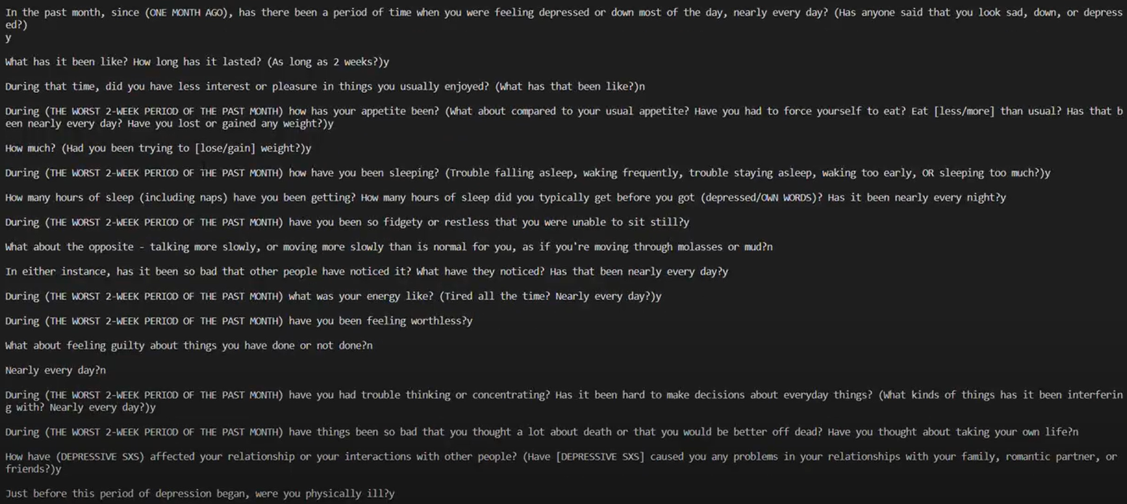
Automated Detection of Major Depressive Disorder (MDD) through Question-Answering
Creating a Baseline Questionnaire Structure (contd…)
Srijanak De
Introduction
Background and Preliminaries
Understanding the Diagnostic Criteria for MDD
Getting Acquainted with the Structure of Questions
Problem Statements
Summary of Work Done
Creating a Baseline Questionnaire Structure
Making the Baseline Adaptive to Newer Contexts and Rules
Future Work and Conclusion
References
Figure 1: Example SCID-5-CV Baseline Question-Answer Pathway

Slide 10
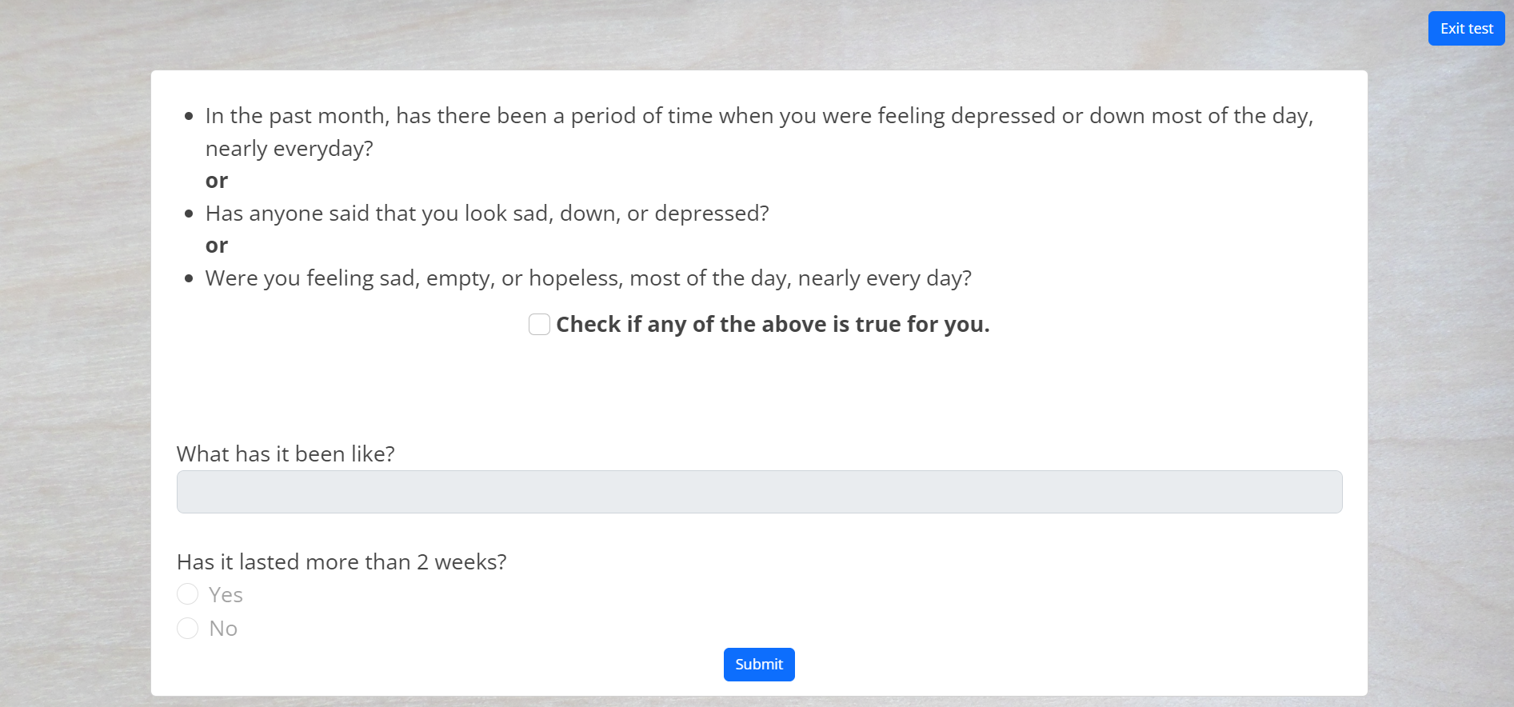
Automated Detection of Major Depressive Disorder (MDD) through Question-Answering
Creating a Baseline Questionnaire Structure (contd…)
Srijanak De
Introduction
Background and Preliminaries
Understanding the Diagnostic Criteria for MDD
Getting Acquainted with the Structure of Questions
Problem Statements
Summary of Work Done
Creating a Baseline Questionnaire Structure
Making the Baseline Adaptive to Newer Contexts and Rules
Future Work and Conclusion
Figure 2: Sample Question Asked in Webapp
References
The questions were framed in order pertaining to each node so that each ‘yes’ or ‘no’ answer suffices to determine their contribution in diagnosis of depression.
The duration for each question and the answers in order are stored on the backend along with relevant details of each user.

Slide 11
Automated Detection of Major Depressive Disorder (MDD) through Question-Answering
Making the Baseline Adaptive to Newer Contexts and Rules
Srijanak De
Introduction
Background and Preliminaries
Understanding the Diagnostic Criteria for MDD
Getting Acquainted with the Structure of Questions
Problem Statements
The pool of questions was increased by creating relevant questions pertaining to personified contexts and Indian demographics vetted by professional clinicians.
The output categories are stored in an array and can be modified based on clinician’s choice.
Each node in the questionnaire tree is a class which contains root to a question tree and a pointer to the left and right child where the left and the right child corresponds to the ‘+’ and the ‘–‘ instances of the node respectively.
Each node in the question tree per questionnaire tree node contains the specific question and a pointer to the left and right child where the left and the right child corresponds to the ‘yes’ and the ‘no’ instances of the question.
Using the tree structure enables easy insertion, deletion and reordering of nodes/questions.
Summary of Work Done
Creating a Baseline Questionnaire Structure
Making the Baseline Adaptive to Newer Contexts and Rules
Future Work and Conclusion
References

Slide 12
Automated Detection of Major Depressive Disorder (MDD) through Question-Answering
Making the Baseline Adaptive to Newer Contexts and Rules (contd…)
Srijanak De
Introduction
Background and Preliminaries
Understanding the Diagnostic Criteria for MDD
Getting Acquainted with the Structure of Questions
Problem Statements
To create the tree dynamically using the tool, a novel representation is proposed. A default structure exists according to SCID-5-CV. To enable further flexibility, users can create/include/re-order nodes as per their choice in the following way:
Let’s define that node A corresponds to lack of sleep, B corresponds to loss of appetite, C corresponds to lack of pleasure/interest and so on. Similarly, individual questions inside a questionnaire node can be categorized into detection of symptom, severity, and duration and can be defined as node A, B and C.
Step X – Let the user choose from a set of nodes. For simplicity, let’s assume the user chose A.
Next choose either 1 or 0 for yes or no respectively. If 1 repeat Step X.
If 0, do Step Y.
Step Y – Either choose Step X or choose 0 again. If 0 again then backtrack to last node and repeat Step Y. If no more nodes exist, exit. Tree is created.
At each stage of the process the created tree is shown to the user.
Summary of Work Done
Creating a Baseline Questionnaire Structure
Making the Baseline Adaptive to Newer Contexts and Rules
Future Work and Conclusion
References

Slide 13
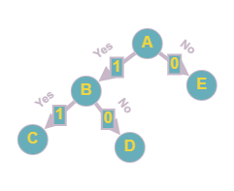
Automated Detection of Major Depressive Disorder (MDD) through Question-Answering
Making the Baseline Adaptive to Newer Contexts and Rules (contd…)
Srijanak De
Introduction
Background and Preliminaries
Understanding the Diagnostic Criteria for MDD
Getting Acquainted with the Structure of Questions
Problem Statements
Figure 3: Sample Questionnaire Tree Structure
The encoding A1B1C000D00E00 describes the tree created above.
First user selects node A among given set of nodes (nodes here can mean either a particular symptom or a specific question pertaining to that symptom).
Then he chooses 1 which corresponds to an ‘yes’ instance.
He again chooses another node B from the given set of nodes. Note that the same question can’t be repeated.
After choosing C, the user chooses the first 0 signifying no further ‘yes’ nodes originate from C, then second 0 means C doesn’t have any branches, third 0 signifies ‘no’ instance of last visited node i.e., node B.
Similarly, the E corresponds to the ‘no’ instance of A.
E is followed by two 0s, no more nodes exist in the tree, so the graph generation stops.
Each step of the process can be dynamically shown to the user for ease of visualization as below.
Summary of Work Done
Creating a Baseline Questionnaire Structure
Making the Baseline Adaptive to Newer Contexts and Rules
Future Work and Conclusion
References

Slide 14
Future Work and Conclusion
Automated Detection of Major Depressive Disorder (MDD) through Question-Answering
Srijanak De
Handling Full Blown Textual Interactions and Responding on the Go.
Once the tool starts accepting textual responses, each response need to be categorized as positive or negative which would correspondingly mean a ‘yes’ or ‘no’ instance for that particular question.
To make the tool adaptive to responding on the go NLU can be used.
Analysis of Responses at the Backend.
Machine learning based predictive analysis and data analysis to find anomalies and patterns.
Simple statistical analysis like duration of responding each question, at which question user’s mostly exit the platform, most common answer orders pertaining to certain age groups, most common words used by people with severe depression.
We hope that, once launched, this tool will likely aid clinicians in detecting depression as well as help reduce the number of depressed people across the world by diagnosing depression at a larger rate than ever before.
Introduction
Background and Preliminaries
Understanding the Diagnostic Criteria for MDD
Getting Acquainted with the Structure of Questions
Problem Statements
Summary of Work Done
Creating a Baseline Questionnaire Structure
Making the Baseline Adaptive to Newer Contexts and Rules
Future Work and Conclusion
References

Slide 15
References
Automated Detection of Major Depressive Disorder (MDD) through Question-Answering
Srijanak De
Introduction
Background and Preliminaries
Understanding the Diagnostic Criteria for MDD
Getting Acquainted with the Structure of Questions
Problem Statements
[1] American Psychiatric Association. (2022). Diagnostic and statistical manual of mental disorders (5th ed., text rev.). https://doi.org/10.1176/appi.books.9780890425787
[2] First, M. B., Williams, J. B. W., Karg, R. S., & Spitzer, R. L. (2016). User's guide for the SCID-5-CV Structured Clinical Interview for DSM-5® disorders: Clinical version (pp 10). American Psychiatric Publishing, Inc.
Summary of Work Done
Creating a Baseline Questionnaire Structure
Making the Baseline Adaptive to Newer Contexts and Rules
Future Work and Conclusion
References

